Slide 1
Data Transfer
Synchronous : All devices derive the timing information from common clock line.
Asynchronous: No common clock
Require control signals
Strobe Pulse
Handshaking

Slide 2
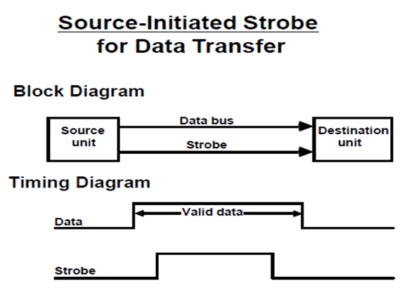
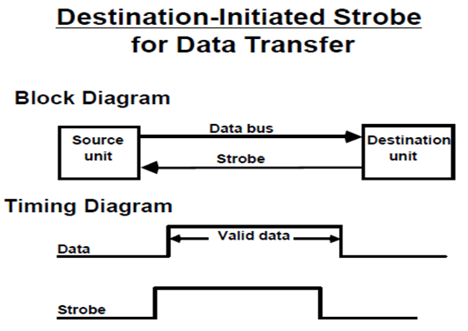
Strobe Control

Slide 3
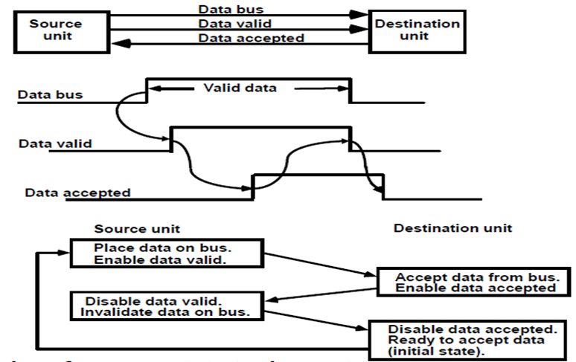
Handshaking
Source initiated transfer using handshake
Block Diagram
Timing Diagram
Sequence of events

Slide 4
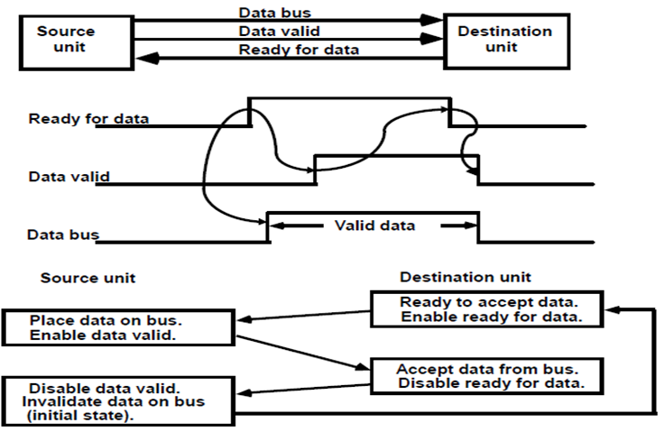
Handshaking
Destination initiated transfer using handshake
Block Diagram
Timing Diagram
Sequence of events

Slide 5
Asynchronous data transmission
A transmitted character can be detected by the receiver from knowledge of the transmission rules:
When a character is not being sent, the line is kept in the 1-state.
The initiation of a character transmission is detected from the start bit, which is always 0.
The character bits always follow the start bit.
After the last bit of the character is transmitted, a stop bit is detected when the line returns to the 1-state for at least one bit time.

Slide 6
Input / Output Subsystem
There are three basic forms of input and output systems
Programmed I/O
Interrupt driven I/O
Direct Memory Access(DMA)

Slide 7
Input / Output Subsystem
Programmed I/O: With programmed I/O, the processor executes a program that gives its direct control of the I/O operation, including sensing device status, sending a read or write command, and transferring the data.
Interrupt driven I/O: With interrupt driven I/O, the processor issues an I/O command, continues to execute other instructions, and is interrupted by the I/O module when the I/O module completes its work.
DMA: In Direct Memory Access (DMA), the I/O module and main memory exchange data directly without processor involvement.

Slide 8
I/O Commands
There are four types of I/O commands that an I/O module will receive when it is addressed by a processor
Control : Used to activate a peripheral device and instruct it what to do. These commands are specific to a particular type of peripheral device.
Test : Used to test various status conditions associated with an I/O module and its peripherals. The processor will want to know if the most recent I/O operation is completed, or any error has occurred.

Slide 9
I/O Commands
Read : Causes the I/O module to obtain an item of data from the peripheral and place it in the internal buffer.
Write : Causes the I/O module to take an item of data ( byte or word ) from the data bus and subsequently transmit the data item to the peripheral.

Slide 10
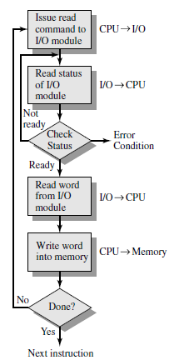
Programmed I/O
With programmed I/O, the processor executes a program that gives its direct control of the I/O operation, including sensing device status, sending a read or write command, and transferring the data.

Slide 11
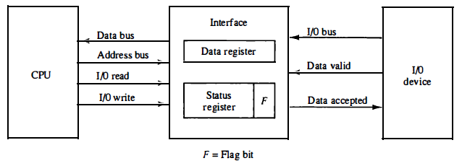
Example

Slide 12
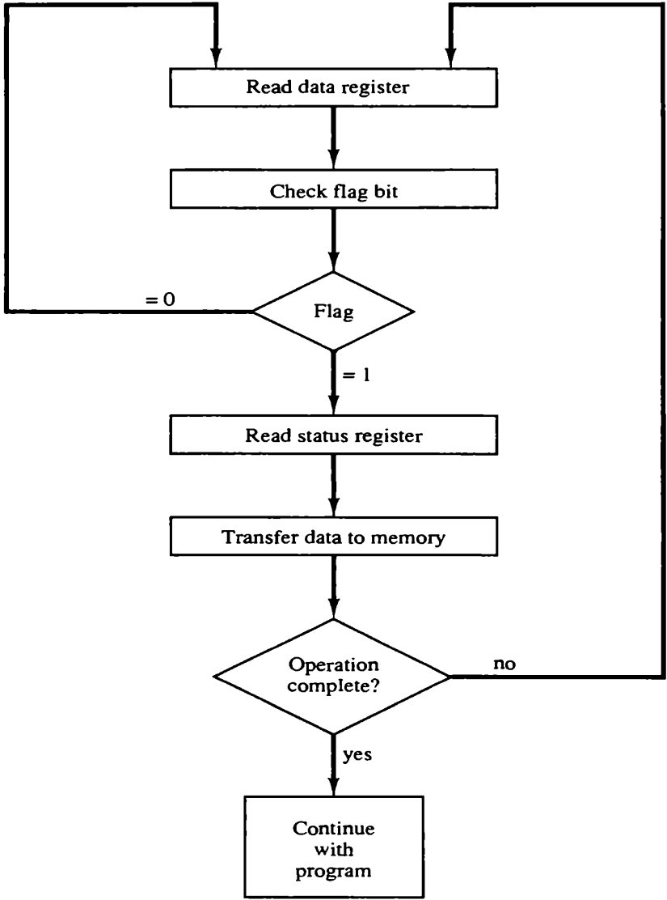
Example
The transfer of each byte requires three instructions:
Read the status register.
Check the status of the flag bit and branch to step 1 if not set or to step 3 if set.
Read the data register.
Flow chart for CPU program to input data

Slide 13
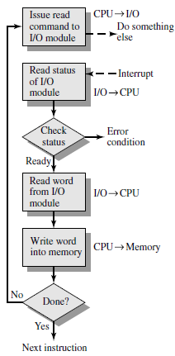
Interrupt driven I/O
With interrupt driven I/O, the processor issues an I/O command, continues to execute other instructions, and is interrupted by the I/O module when the I/O module completes its work.

Slide 14
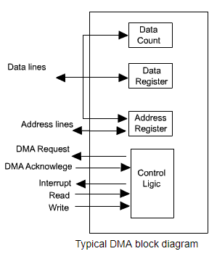
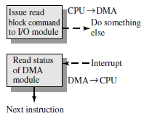
Direct Memory Access (DMA)

Slide 15
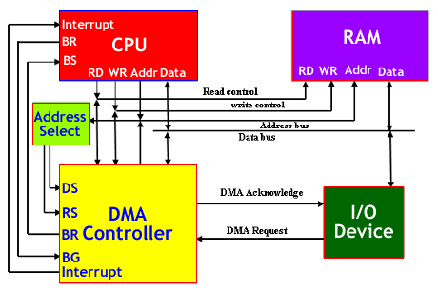
DMA Transfer

Slide 16
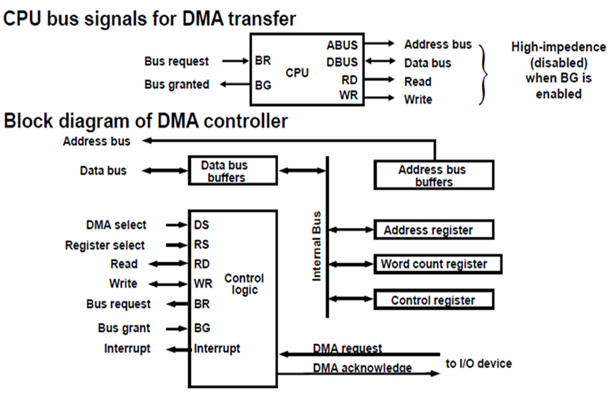
Direct Memory Access

Slide 17
DMA Modes of Operation
DMA performs data transfer operation. The different DMA transfer modes are as follows:-
Burst or block transfer DMA
Cycle steal or single byte transfer DMA.
Transparent or hidden DMA.

Slide 18
Burst or block transfer DMA
It is the fastest DMA mode. In this two or more data bytes are transferred continuously.
Processor is disconnected from system bus during DMA transfer. N number of machine cycles are adopted into the machine cycles of the processor where N is the number of bytes to be transferred.
DMA sends HOLD signal to processor to request for system bus and waits for HLDA signal.
After receiving HLDA signal, DMA gains control of system bus and transfers one byte. After transferring one byte, it increments memory address, decrements counter and transfers next byte.
In this way, it transfer all data bytes between memory and I/O devices. After transferring all data bytes, the DMA controller disables HOLD signal & enters into slave mode.

Slide 19
Cycle steal or single byte transfer DMA
In this mode only one byte is transferred at a time. This is slower than burst DMA.
DMA sends HOLD signal to processor and waits for HLDA signal on receiving HLDA signal, it gains control of system bus and executes only one DMA cycle.
After transfer one byte, it disables HOLD signal and enters into slave mode.
Processor gains control of system bus and executes next machine cycle. If count is not zero and data is available then the DMA controller sends HOLD signal to the processor and transfer next byte of data block.

Slide 20
Transparent or Hidden DMA transfer
Processor executes some states during which is floats the address and data buses. During this process, processor is isolated from the system bus.
DMA transfers data between memory and I/O devices during these states. This operation is transparent to the processor.
This is slowest DMA transfer. In this mode, the instruction execution speed of processor is not reduced. But, the transparent DMA requires logic to detect the states when the processor is floating the buses.

Slide 21
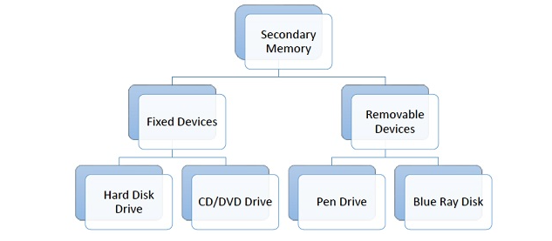
Introduction to secondary memory devices
To store large amount of data or programs permanently, we need a cheaper and permanent memory. Such memory is called secondary memory.
Depending on whether secondary memory device is part of CPU or not, there are two types of secondary memory – fixed and removable.

Slide 22
Hard Disk Drive:Hard disk drive is made up of a series of circular disks called platters arranged one over the other. Disks are made of non-magnetic material like aluminum alloy and coated with 10-20 nm of magnetic material.
CD Drive:CDs are circular disks that use optical rays, usually lasers, to read and write data.
CD-ROM (Compact Disk – Read Only Memory) − The data on these CDs are recorded by the manufacturer. Proprietary Software, audio or video are released on CD-ROMs.
CD-R (Compact Disk – Recordable) − Data can be written by the user once on the CD-R. It cannot be deleted or modified later.
CD-RW (Compact Disk – Rewritable) − Data can be written and deleted on these optical disks again and again.
DVD Drive:DVD stands for Digital Video Display. DVD are optical devices that can store 15 times the data held by CDs. They are usually used to store rich multimedia files that need high storage capacity. DVDs also come in three varieties – read only, recordable and rewritable.

Slide 23
Pen Drive:Pen drive is a portable memory device that uses solid state memory rather than magnetic fields or lasers to record data. It uses a technology similar to RAM, except that it is nonvolatile. It is also called USB drive, key drive or flash memory.
Blu Ray Disk:Blu Ray Disk (BD) is an optical storage media used to store high definition (HD) video and other multimedia filed. BD uses shorter wavelength laser as compared to CD/DVD. This enables writing arm to focus more tightly on the disk and hence pack in more data. BDs can store up to 128 GB data.
Characteristics of Secondary Memory
It is non-volatile, i.e. it retains data when power is switched off
It is large capacities to the tune of terabytes
It is cheaper as compared to primary memory
Connected to main memory through a bus and a device controller.
Only occasionally interacts with CPU
Contents are easily changed, but access is very slow compared to main memory.

Slide 24
END
OF
CO - 3

